Slide 1
MAT 350
Engineering mathematics
Laplace Transformation
Inverse Laplace Transformation
Lecture: 9 Part: B
Dr. M. Sahadet Hossain (Mth)
Professor
Department of Mathematics and Physics, NSU.

Slide 2

7.3 OPERATIONAL PROPERTIES I
(of Laplace Transformation)
REVIEW MATERIAL
  ● Keep practicing partial fraction decomposition
  ● Completion of the square
$$=$$

Slide 3

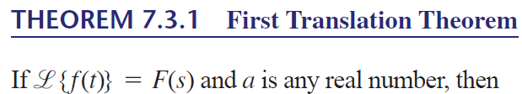
Proof:
s is shifted by s-a.
Hence, F(s) is changed to F(s-a)

Slide 4
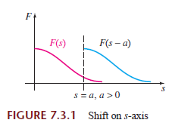
For emphasis it is sometimes useful to use the symbolism
where s→ s-a means that in the Laplace transform F(s) of f (t) we replace the symbol s wherever it appears by s-a.

Slide 5
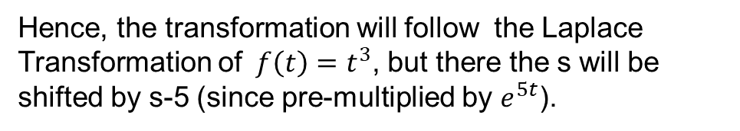

Using the Translation Theorem
Solution: (a)
Note that here$f\left(t\right)=t^{3},$
$$and it is premultiplied by e^{5t}$$
Hence, the transformation will follow the Laplace Transformation of$f\left(t\right)=t^{3}$, but there the s will be shifted by s-5 (since pre-multiplied by $e^{5t}$).

Slide 6

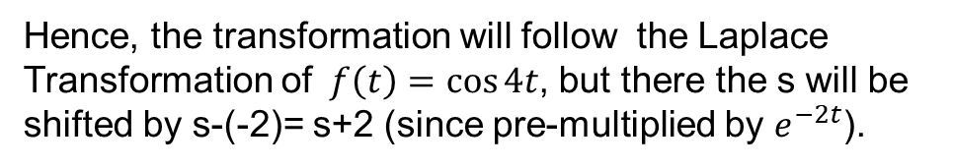

$$and it is premultiplied by e^{−2t}$$
Note that here$f\left(t\right)=\cos{4t},$
Hence, the transformation will follow the Laplace Transformation of$f\left(t\right)=\cos{4t}$, but there the s will be shifted by s-(-2)= s+2 (since pre-multiplied by $e^{−2t}$).
s→ s-(-2)
s→ s+2

Slide 7




Solution.
Direct Inverse Laplace of the rational function is not possible. Hence we seek for it’s partial fractions
Mathematical manipulation implies
Now, s=3 implies B=11, and s=0 (or any value) implies A=2
Hence,
Next Slide

Slide 8


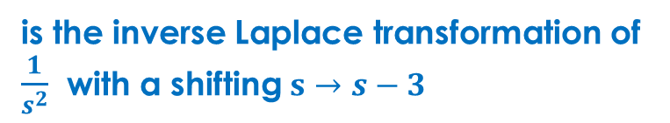

Therefore,
Now,
$$=$$
and
is the inverse Laplace transformation of $\frac{1}{s^{2}}$ with a shifting $s→s−3$
Finally,

Slide 9


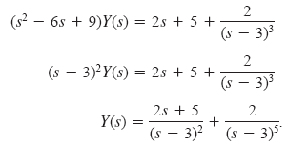
We did the partial fraction in example 2

Slide 10




Using partial fraction:
We know,
Hence,

Slide 11



Exercise 7.3
Use the Laplace transform to solve the given initial-value problem
Solution:

Slide 12




Solution:
The Inverse Laplace then gives

Slide 13
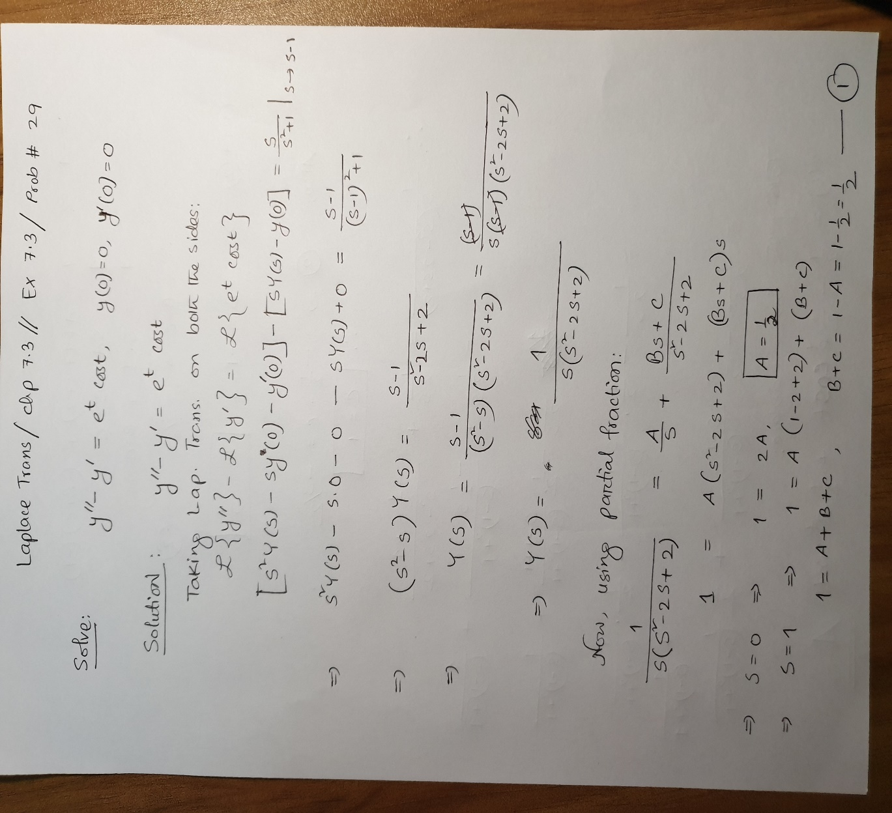
Solution:

Slide 14
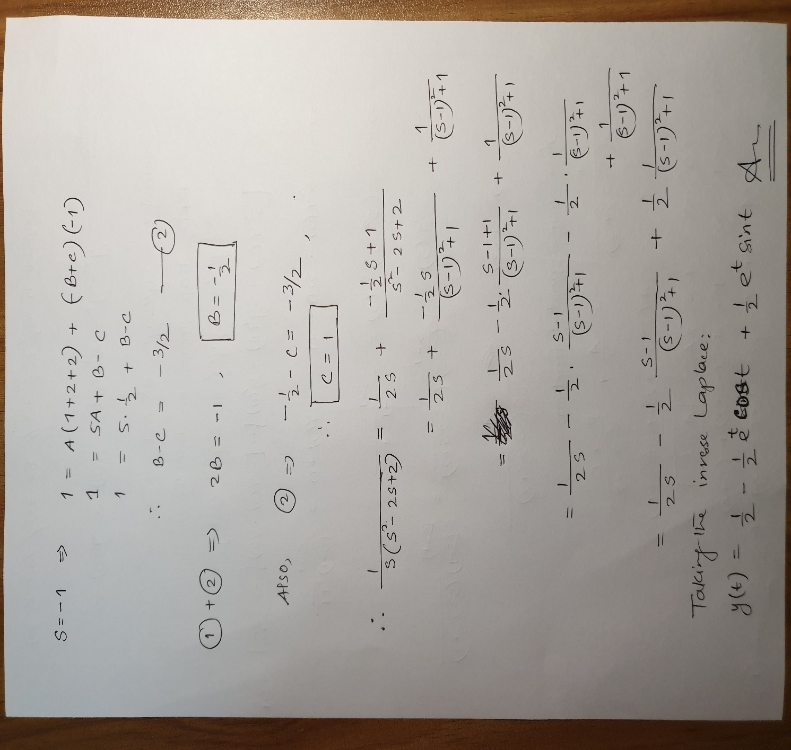

Slide 15
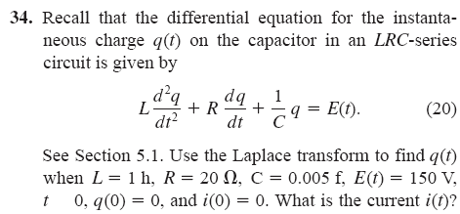



=
Solution:
Note: dq/dt = i(t),
i(0)=0 implies dq/dt at t=0 is 0 (zero).

Slide 16





+

Slide 17
To Do List
Chapter 7.3
Problems#2, 3, 13, 16,22,23,25,26,28, 29,30

Slide 18
Thank You.

